Slide 1
Project Timesheet Tracker

Slide 2
Existing system :
Timesheet tracker is a practice of tracking time spent by employees.
This is a set of data that helps to analyze how much time is spent on the project or a task they are assigned with.
This software helps to reduce employee time theft.
With advanced technology, software that helps to give accurate data and store all the important information on the database.
To get the most efficiency we need tools that are easy to operate, low maintenance and are accessible remotely with ease.

Slide 3
Need of project:
The Project Timesheet Portal is based on time records in the timesheets related to the appropriate projects.
Timesheet Portal to help to assign the task of employee from manager.
Also Timesheet Portal helps to store the data of employee’s work.
This can help create an environment where people feel their timesheets and time records are more important than the value of their work output

Slide 4
PROPOSED SYSTEM:
The Manager Shall login to the system and add the project.
The employee shall login to the system and add there task and work.
Manager should be edit project details.

Slide 5
OBJECTIVE OF SYSTEM:
Minimize paperwork - All type of work related data is store in software.
Faster Process - All type of information is available in system, so work speed is high.
Centralized - All type of data and the activities related to the system ,
It will be kept in a single place so that easy to monitor.
The main objective of timesheet tracker is storage format to store and track data performed by an individual worker. on a particular day either on their own assigned or some other project of their choice were analyzed carefully.

Slide 6
SCOPE OF WORK:
This project can be implemented at any field of work to store data regarding the workers and their work.
On an account of which calculating salaries and knowing the efficiency of the worker becomes easy.
Large amounts of data can be stored and accessed efficiently and systematically.
Privacy regarding the data is maintained, only authorized users can access the data.

Slide 7
MODULE SPECIFICATION:
Administration Management
Manager
Employee
Project Management
In this module project manage by the Manager.
Task Management
In this module Employee and Manager can manage the tasks.
Dashboard management
Personal Details management

Slide 8
OPERATING ENVIRONMENT
Hardware Requirement
The hardware requirement actually depends on the version of java you want to use. The java 8 version requires following hardware configuration :-
RAM : 2 GB
Disk Space : 16 GB
Processor : Pentium 2 266 MHz Processor
Software Requirement
Nowadays, Java is supported by almost every operating systems. Whether it is a Windows, Macintosh and Unix all supports the Java application development. So you can download any of the operating system on your personal computer.
JAVA IDE
JAVA JDK
Operating System

Slide 9
TECHNOLOGY USED
Front-end :
JAVA (swing)
Back-end
MySQL

Slide 10
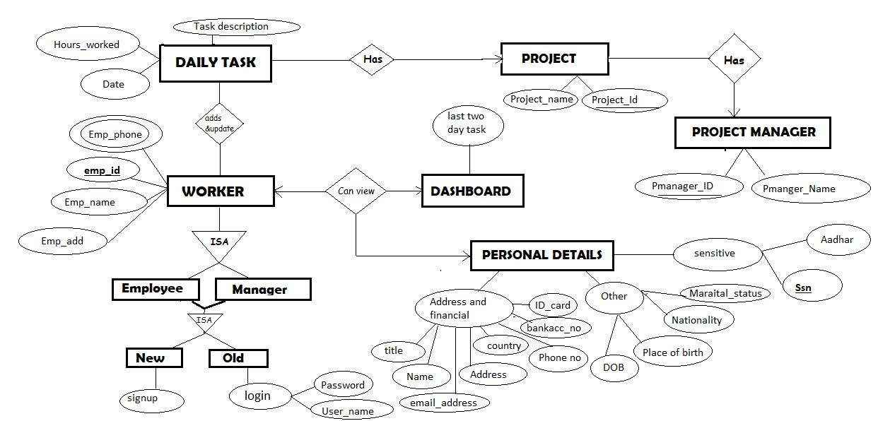
ANALYSIS & DESIGN
ER Diagram

Slide 11
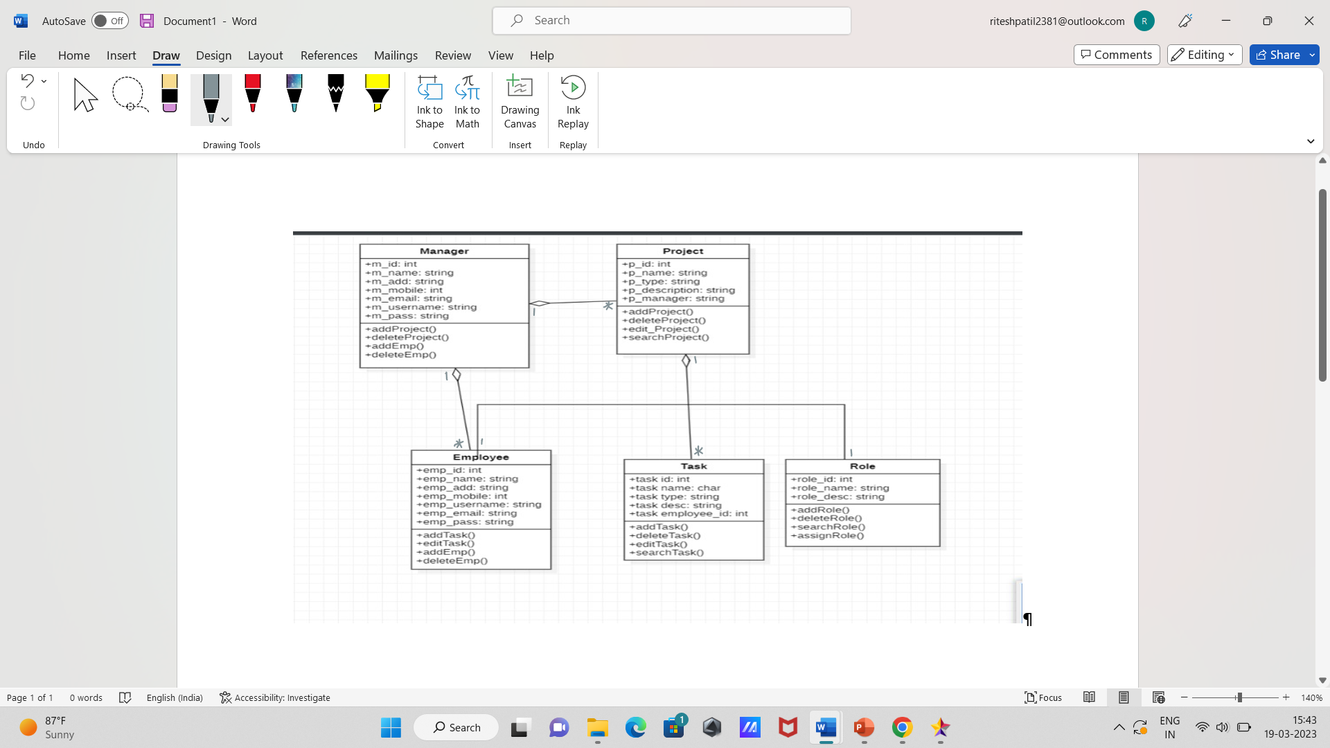
.
Class Diagram:

Slide 12
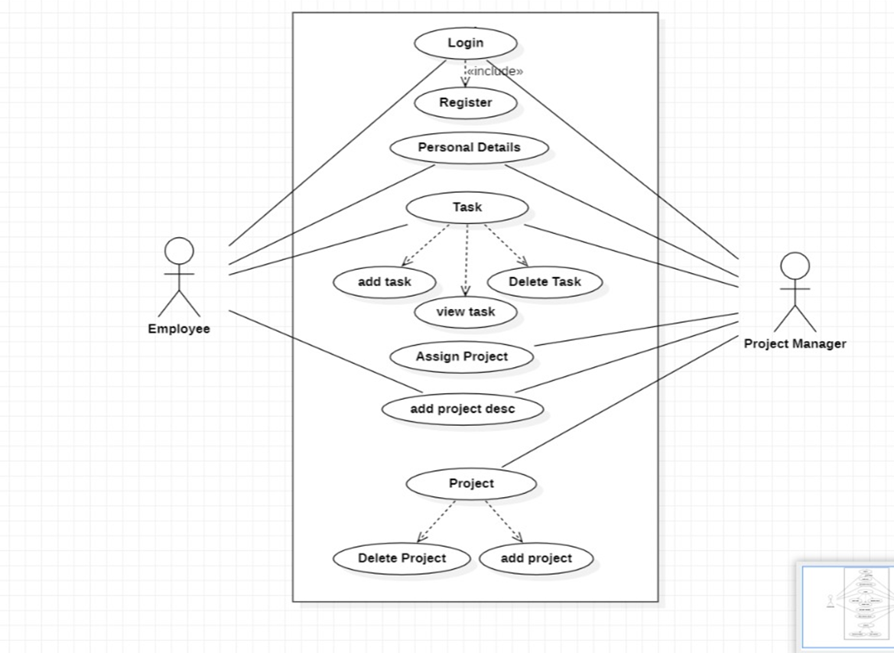
Use Case Diagram:

Slide 13
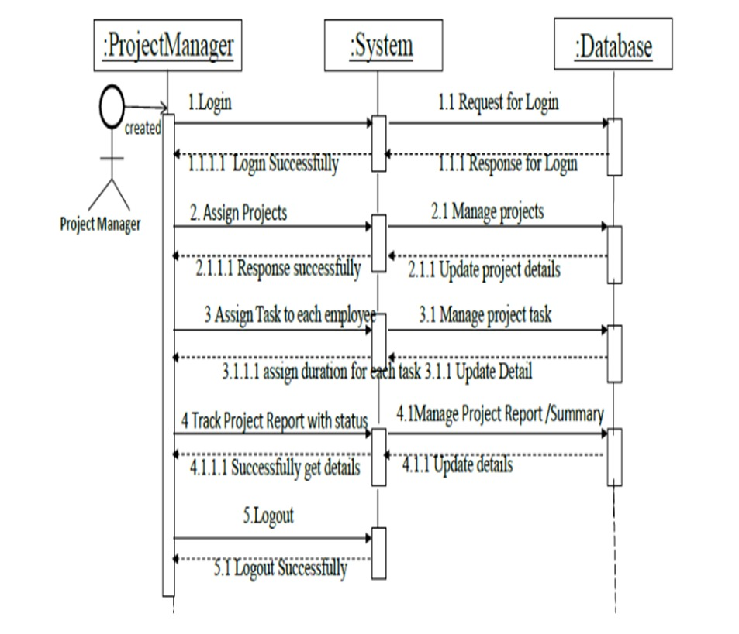
Sequence Diagram: Sequence Diagram for Manager

Slide 14
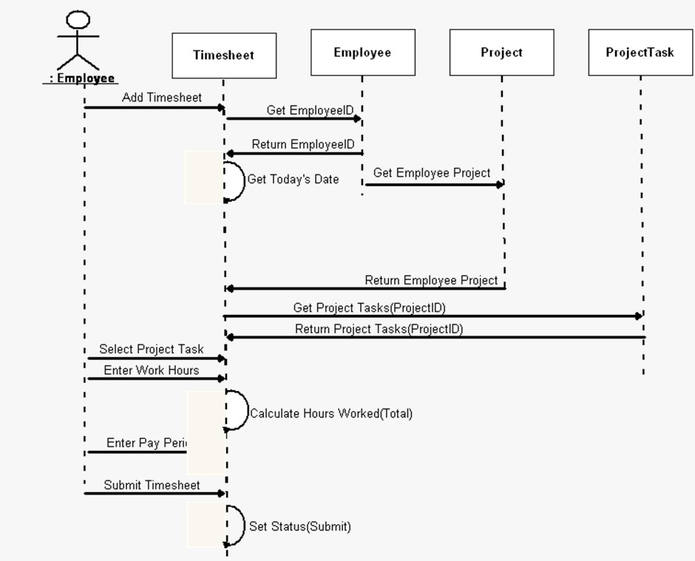
Sequence Diagram for Employee

Slide 15
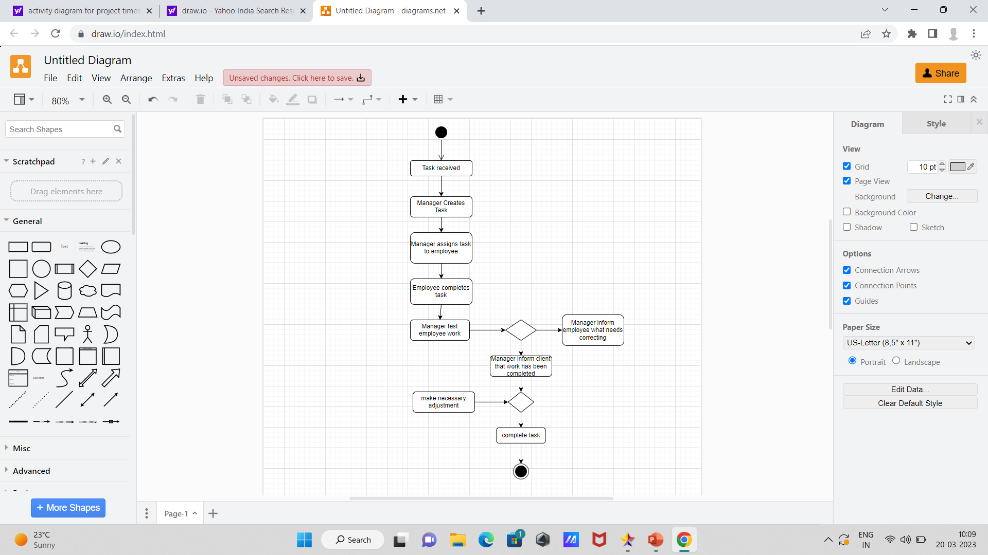
Activity Diagram:

Slide 16
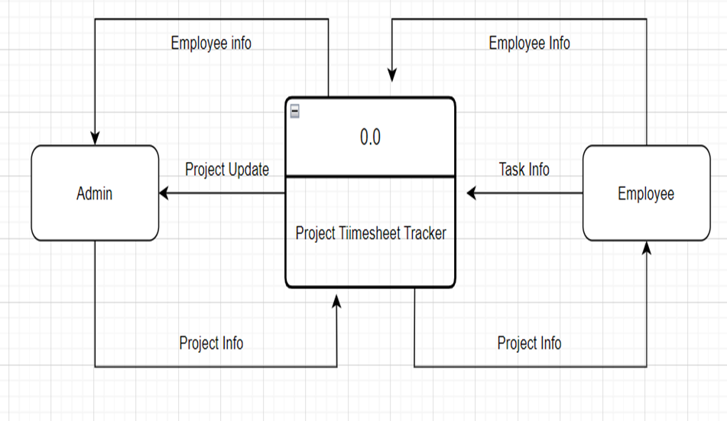
Zero Level DFD

Slide 17
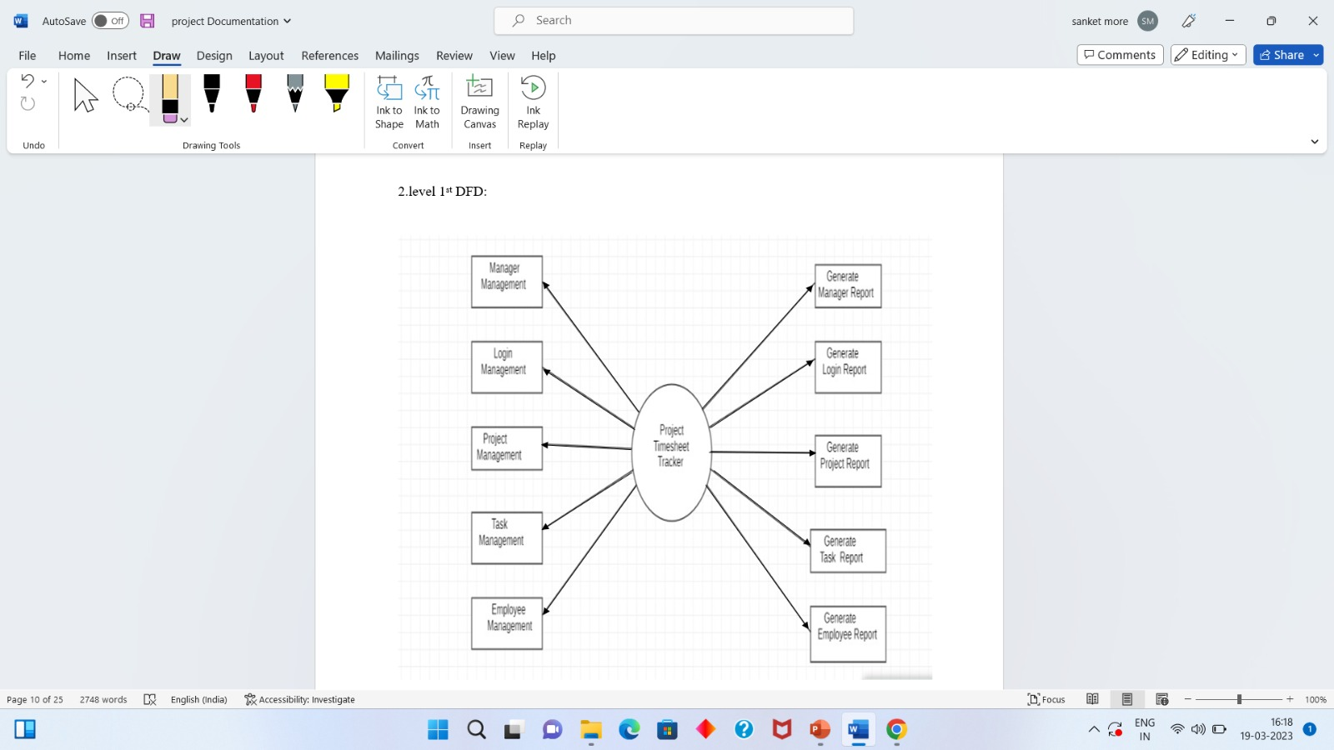
Data Flow Diagram: DFD For First Level

Slide 18
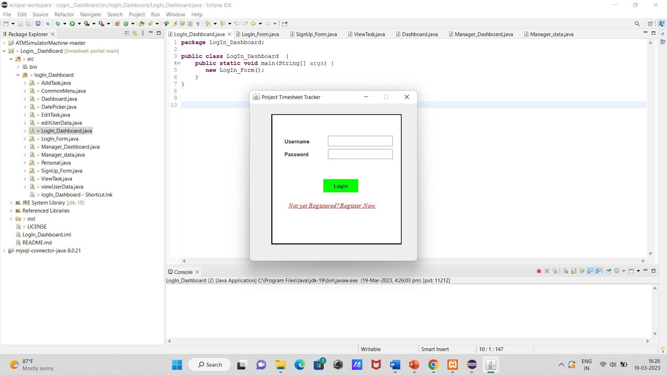
USER INTERFACE DESIGN Login Screen

Slide 19
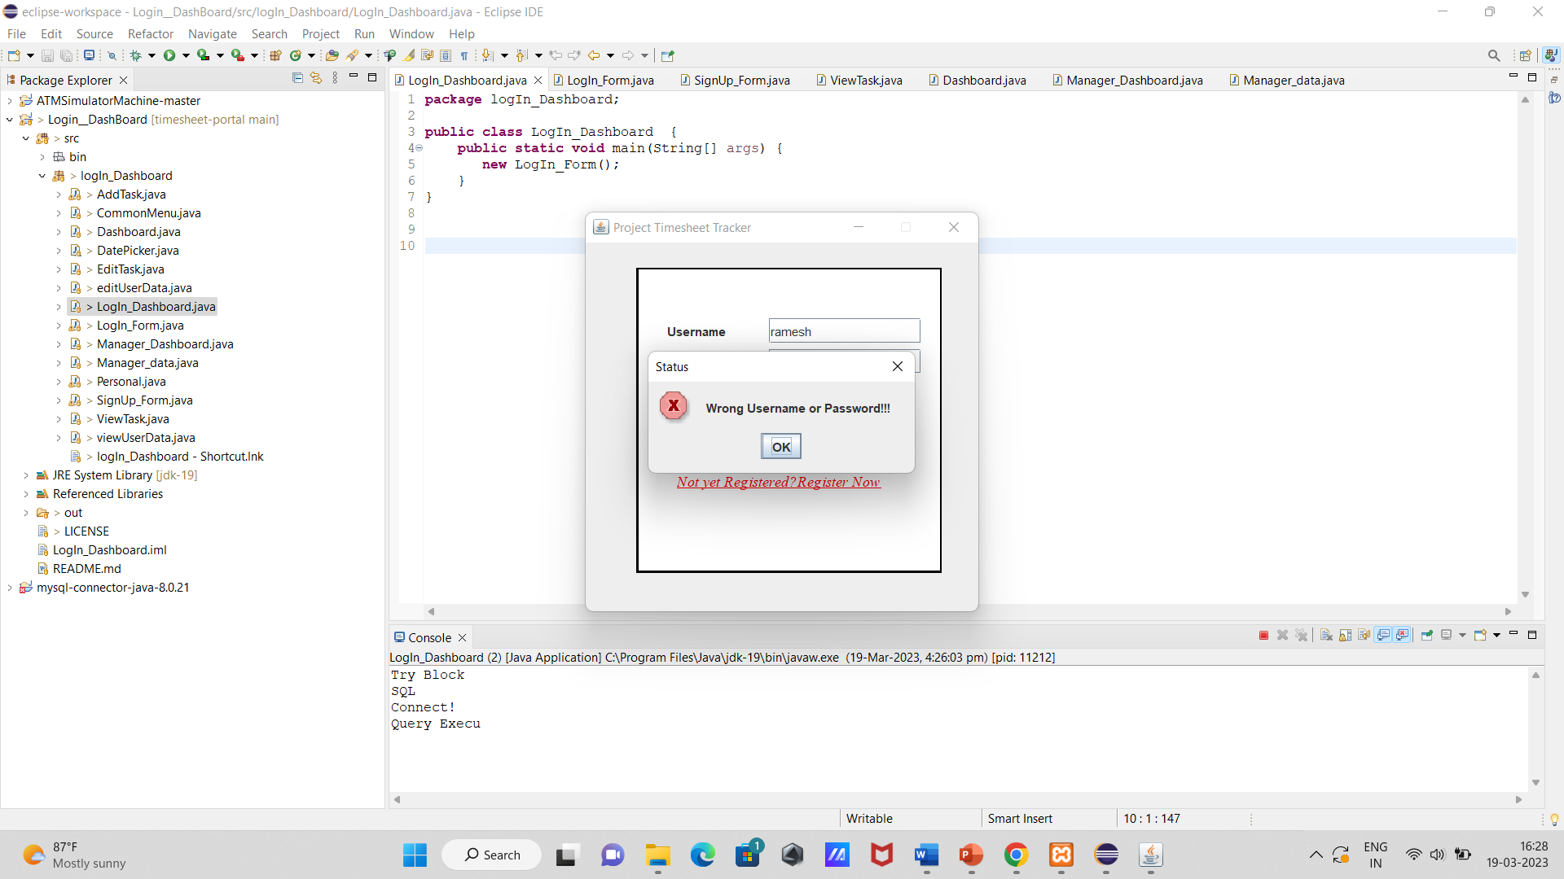
Login Validation Screen

Slide 20
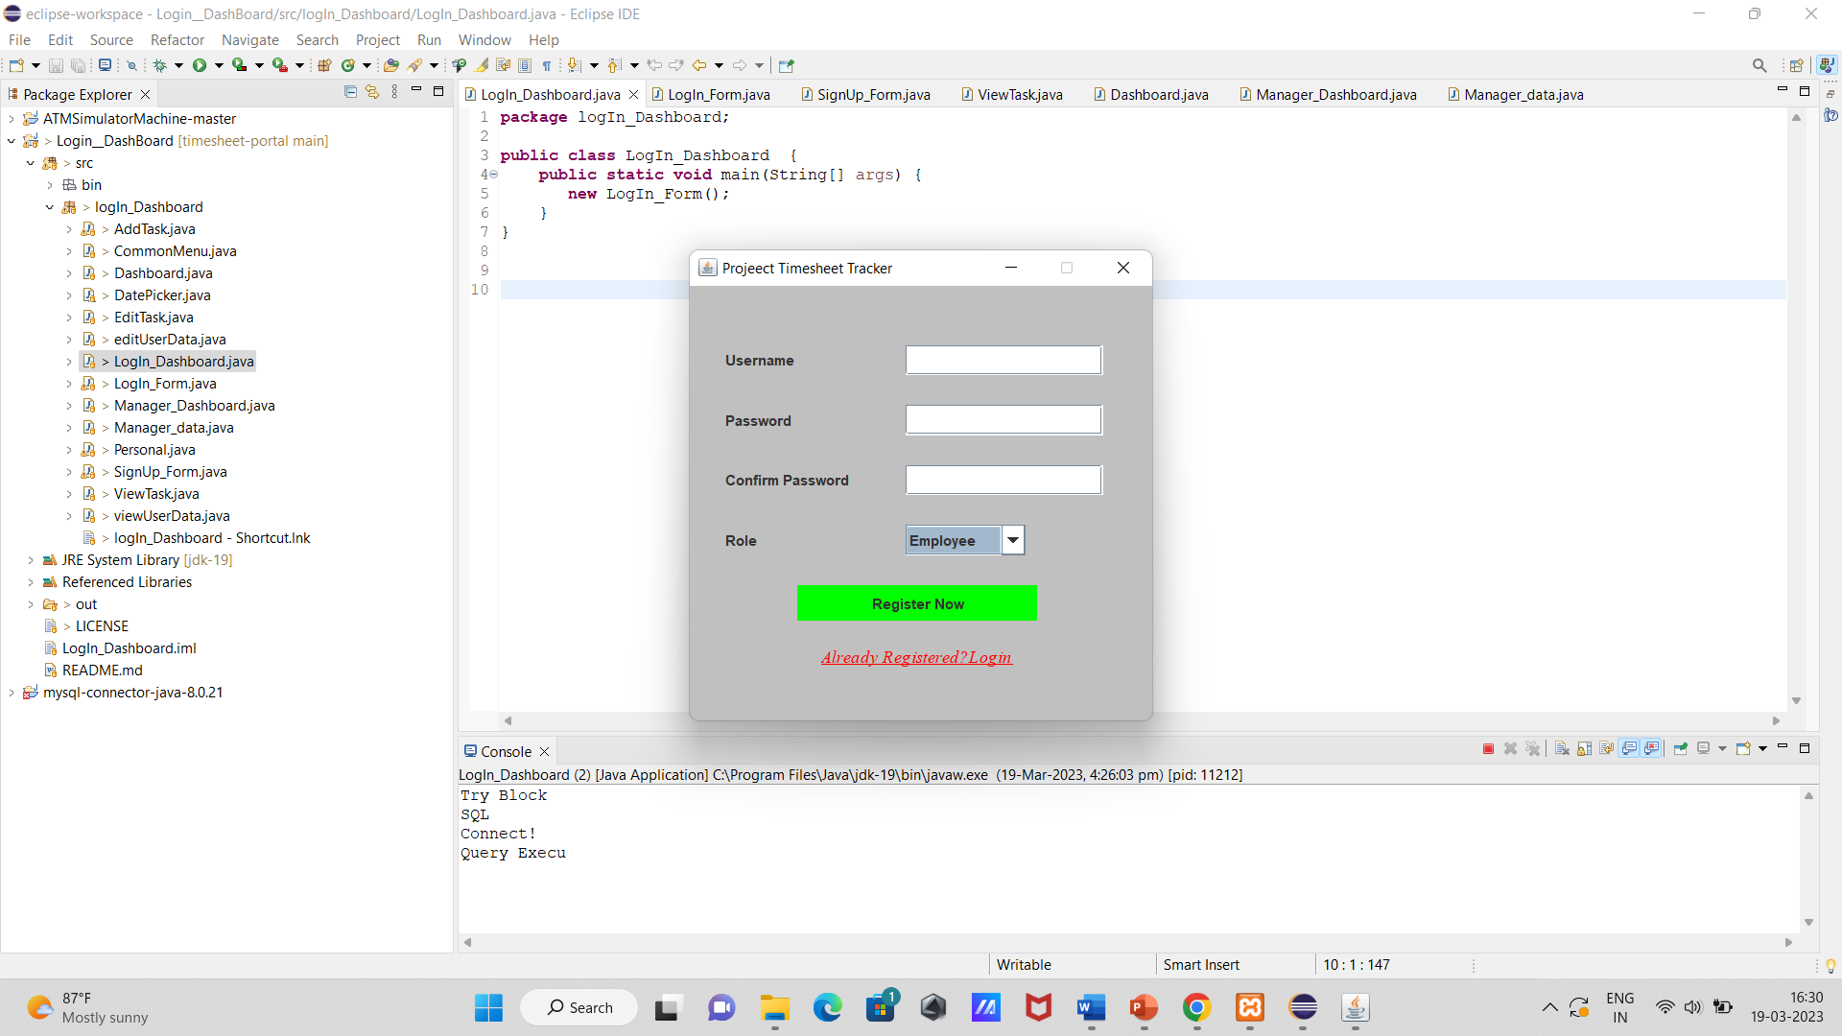
Registration Page

Slide 21
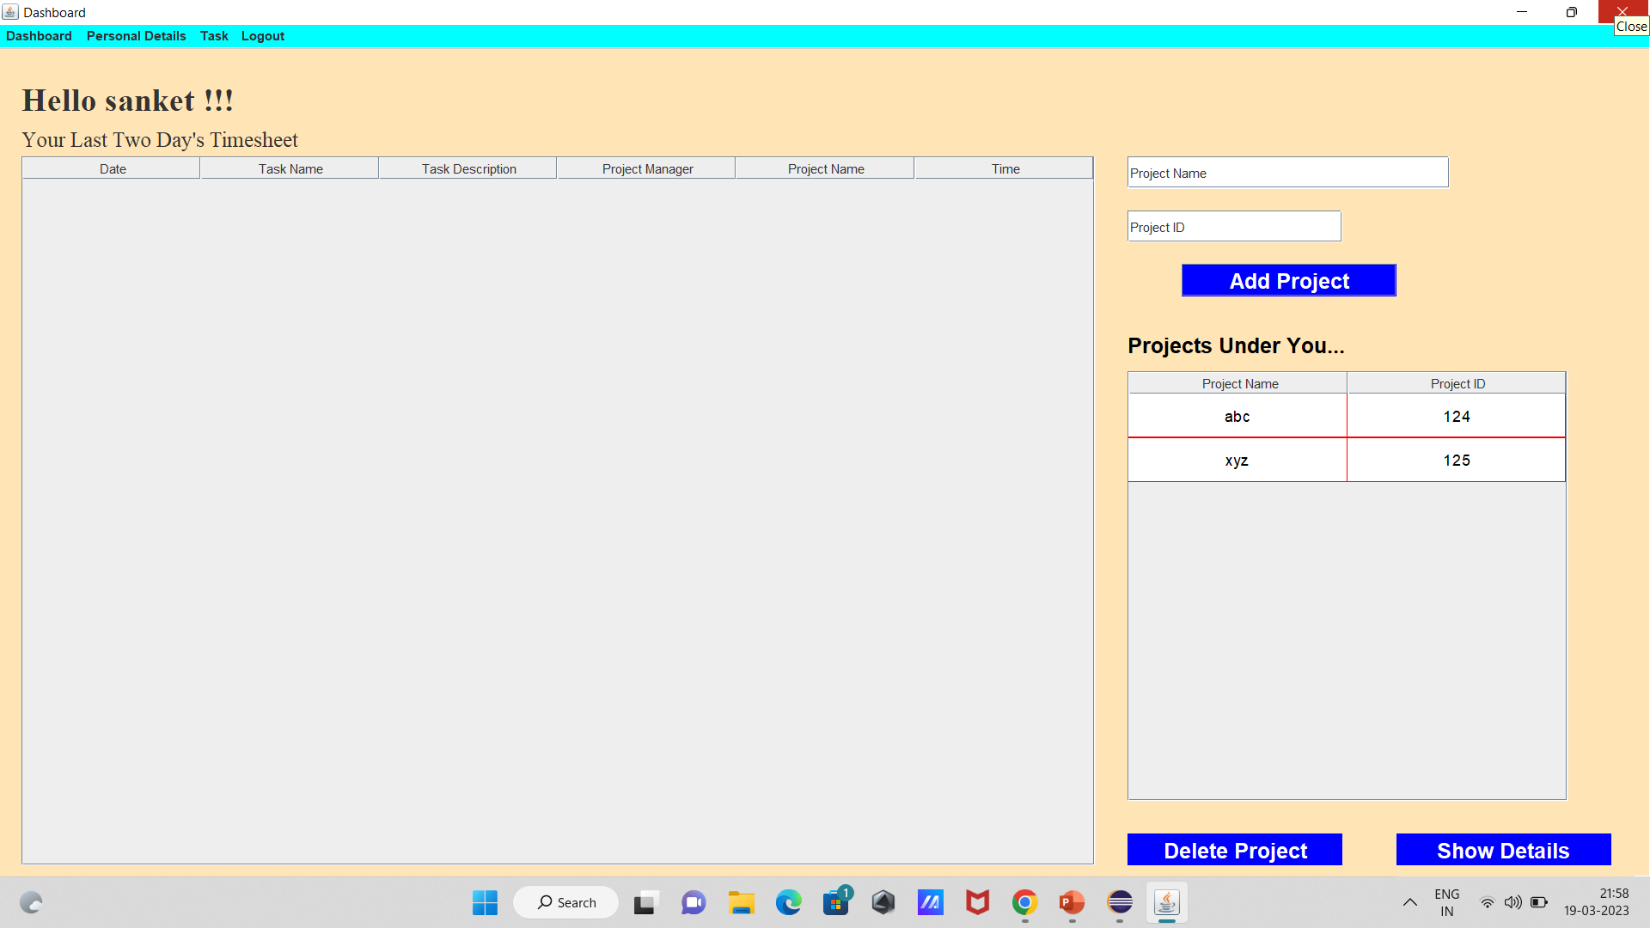
Add Project Screen

Slide 22
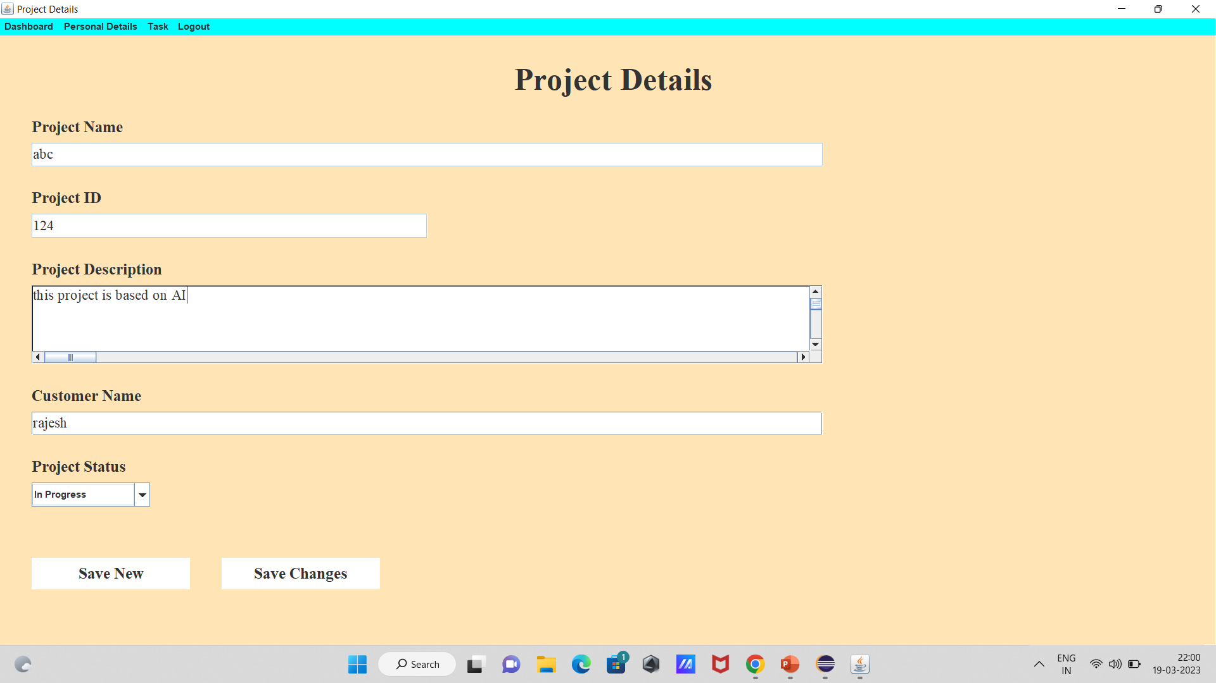
Project Details

Slide 23
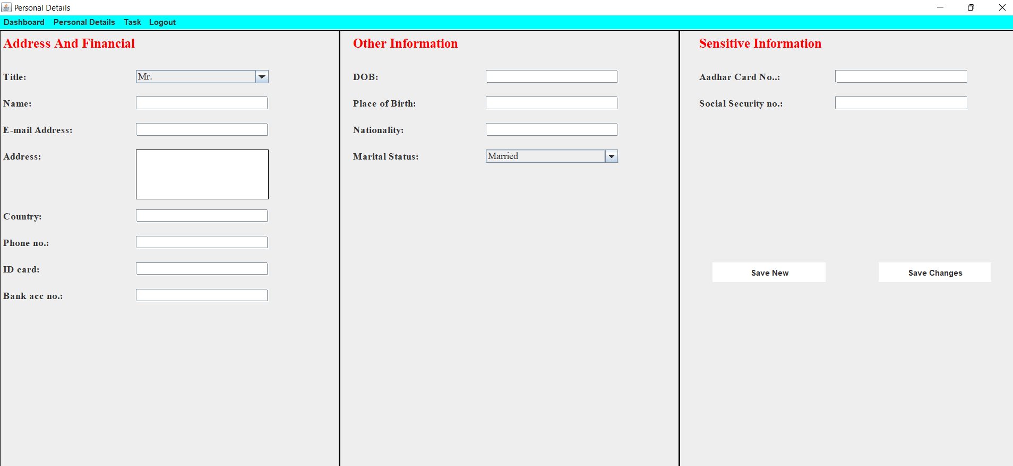
Personal Details

Slide 24
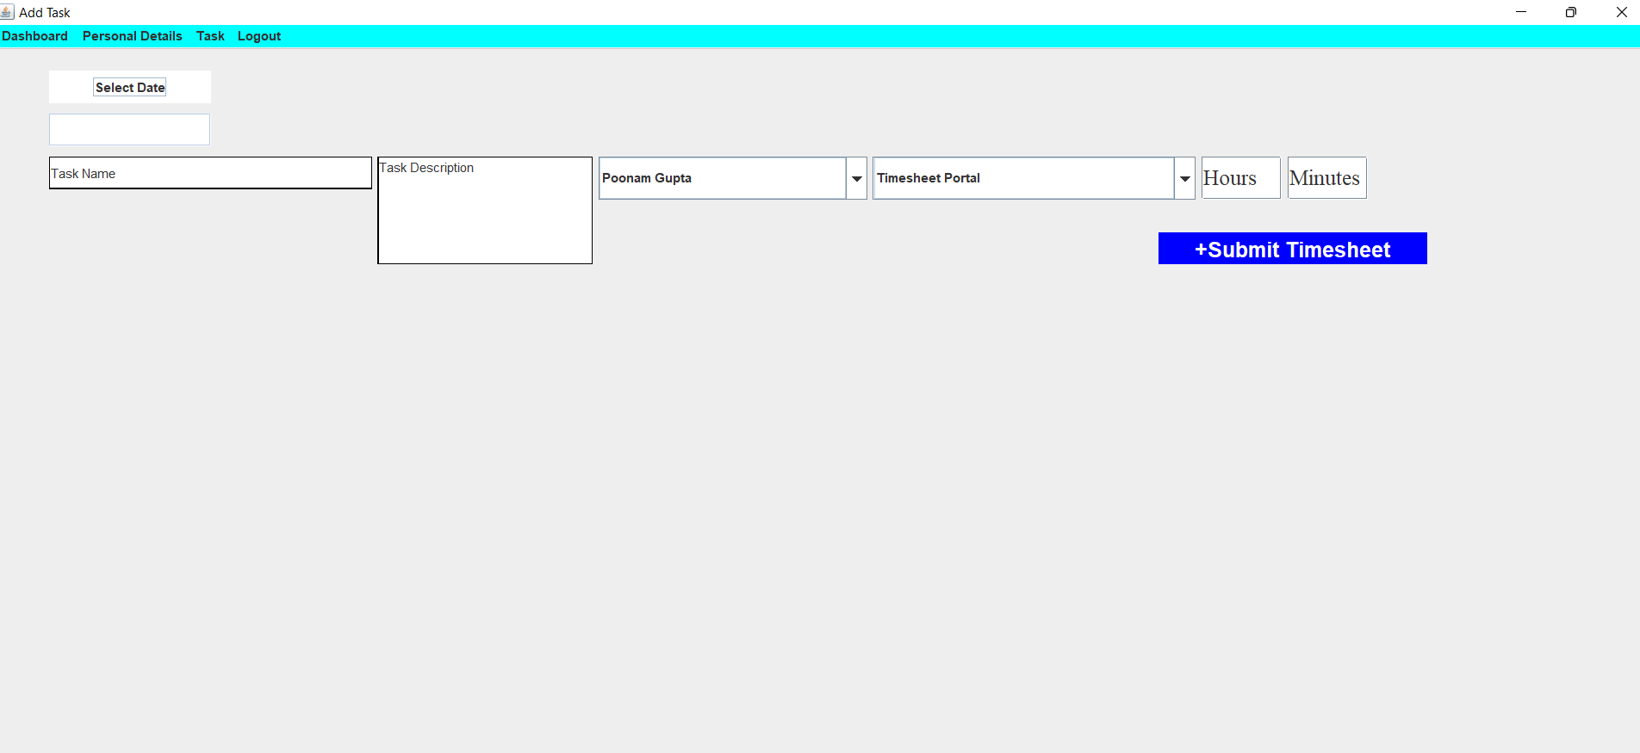
Edit Task:

Slide 25
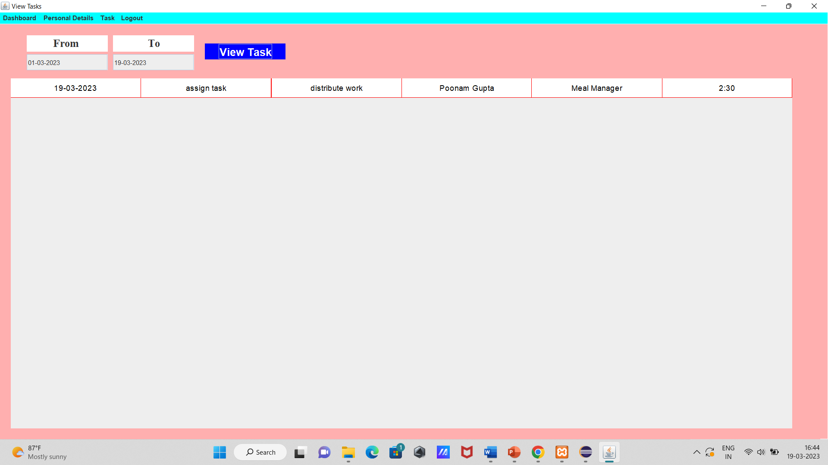
View Task

Slide 26
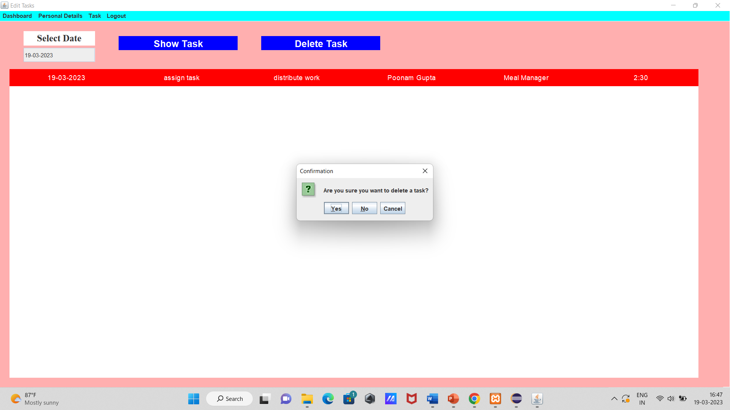
Delete Task

Slide 27
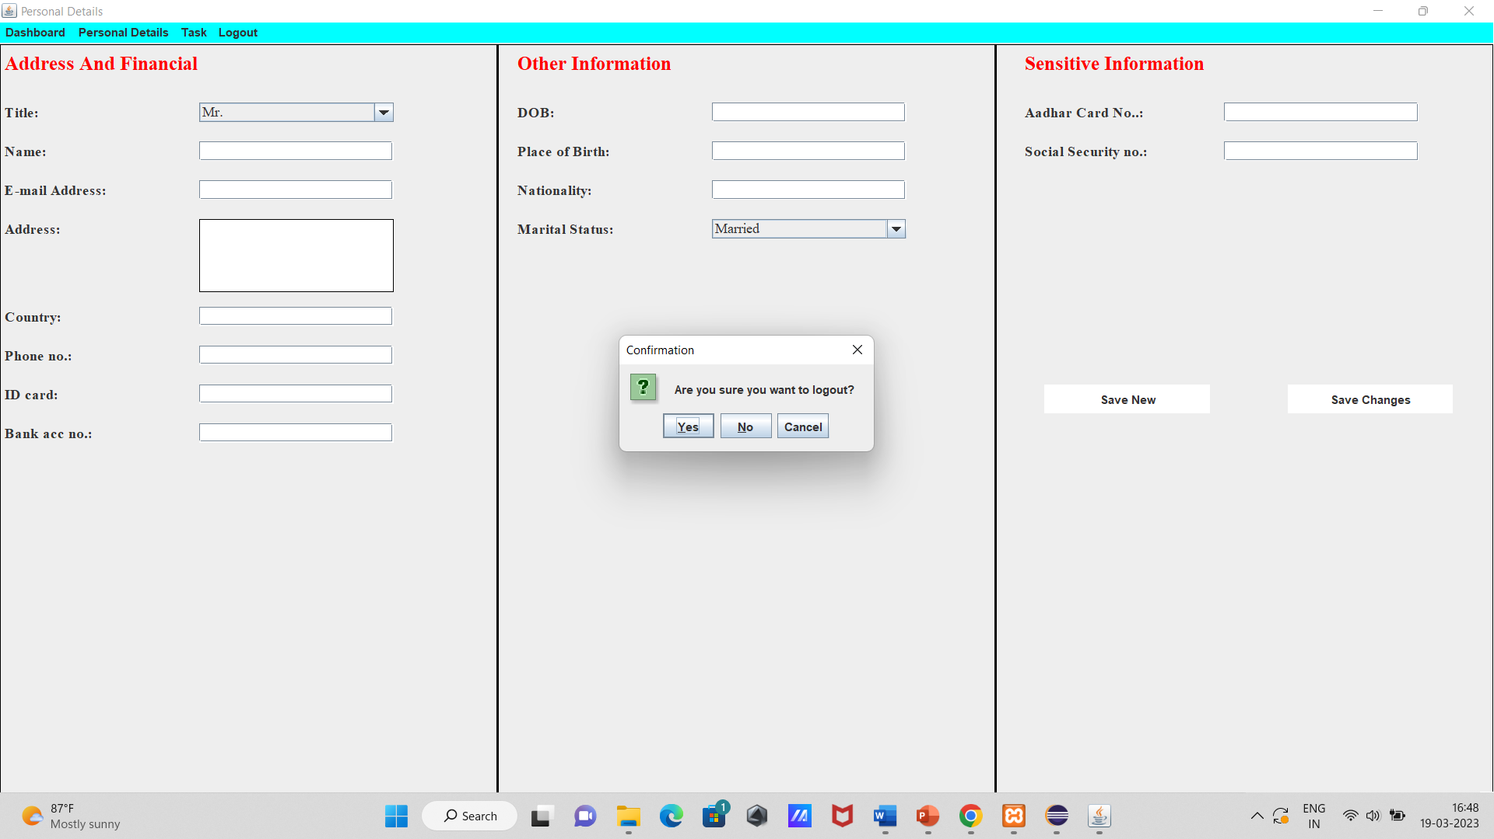
Logout

Slide 28
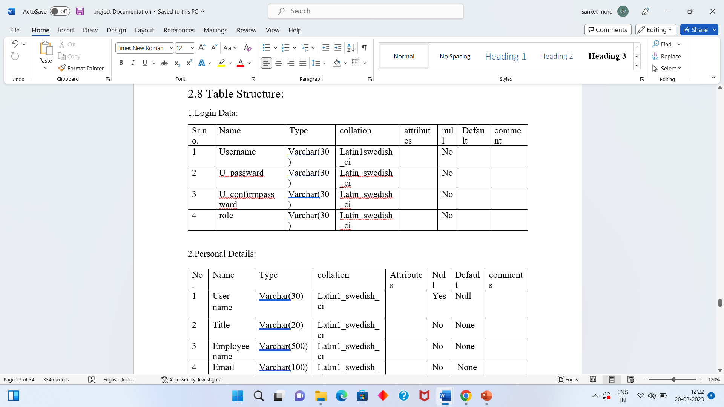
DATA DICTIONARY
Login Data

Slide 29
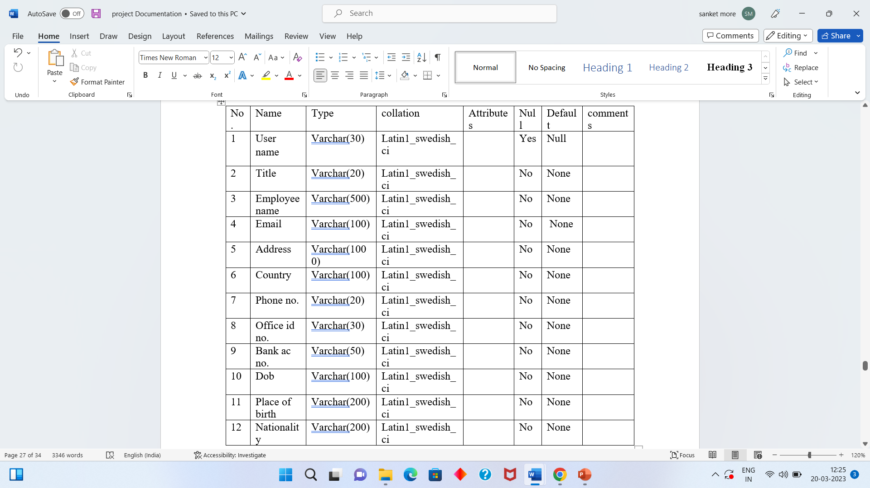
Personal Details

Slide 30
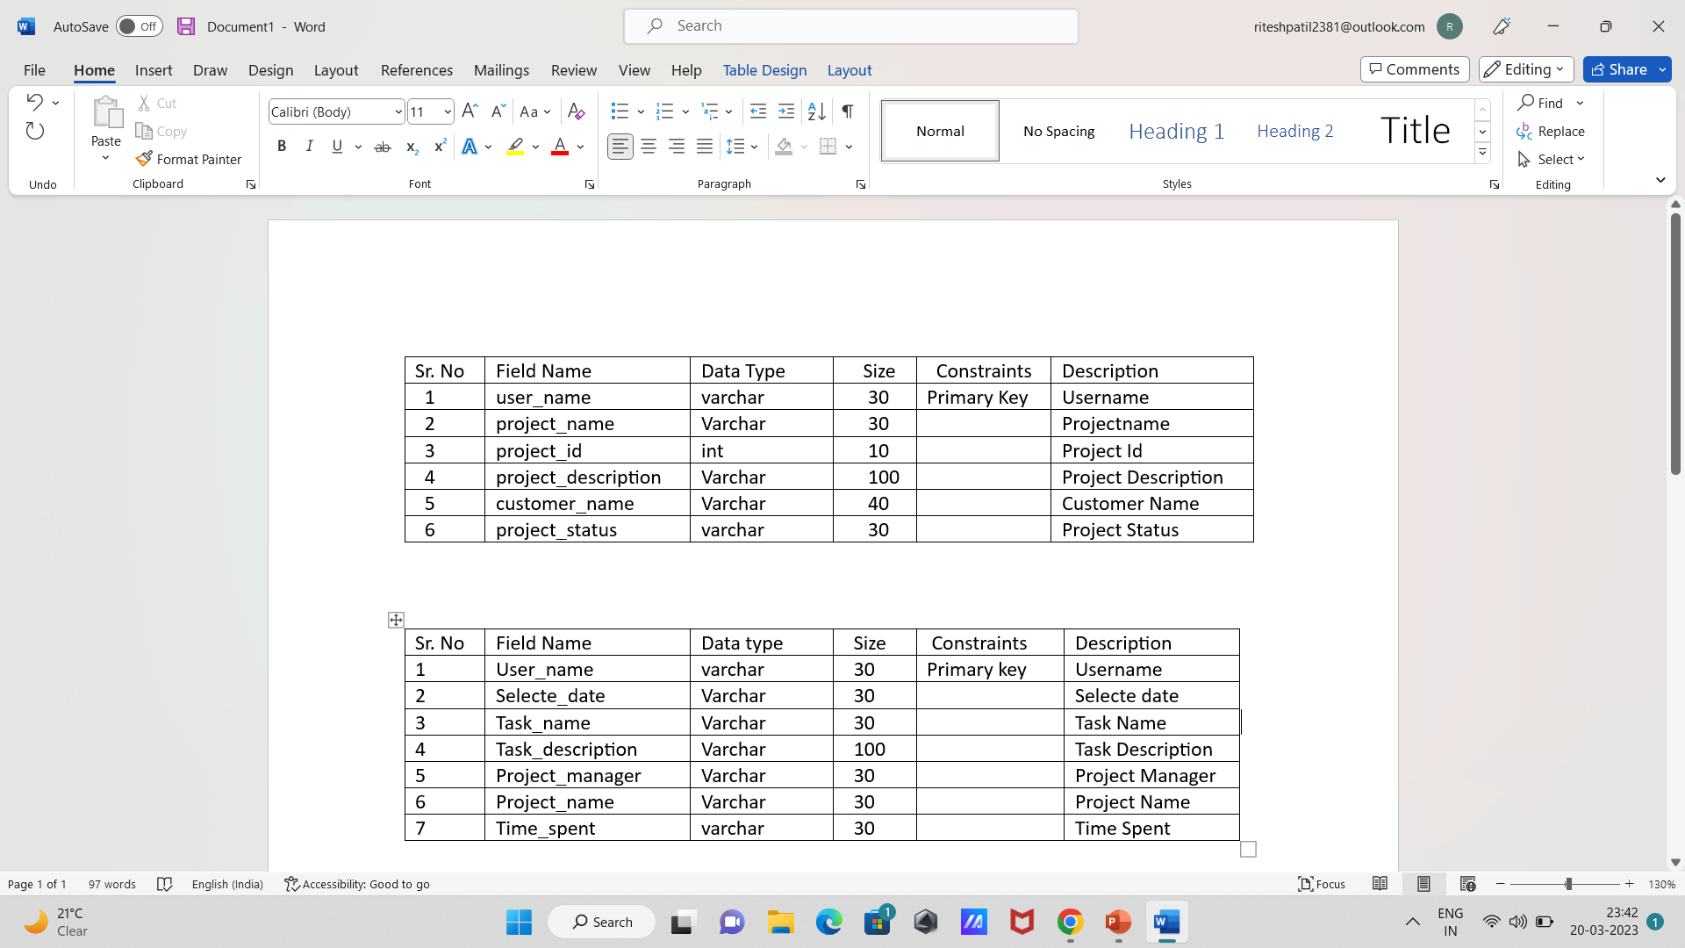
Project Details

Slide 31
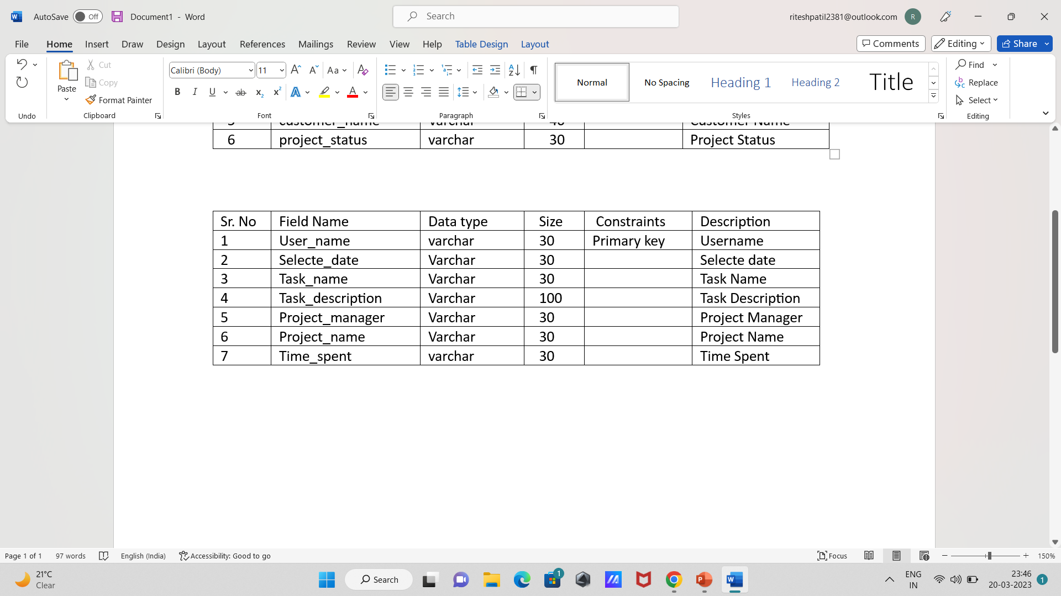
Add Task

Slide 32
DRAWBACKS & LIMITATIONS
Advantages
Time tracking allows managers to get a clear picture of an employee’s performance at a glance.
The point of tracking time is to spend less time on managing employees.
These systems let managers supervise more efficiently without picking or observing every detail of the work process.

Slide 33
PROPOSED ENHANCEMENT
On an account of which calculating salaries and knowing the efficiency of the worker becomes easy.
Large amounts of data can be stored and accessed efficiently and systematically.
Privacy regarding the data is maintained, only authorized users can access the data.

Slide 34
THANK YOU

